Slide 1
8085 instructions
Dr R THILAK KUMAR

Slide 2
8085 Instructions
An instruction is a binary pattern designed inside a microprocessor to perform a specific function. The entire group of instructions called the instruction set, determines what functions the microprocessor can perform.
The 8085 instructions can be classified into the following five functional categories;
Data transfer (copy) operations
Arithmetic operations
Logical operations
Branching operations and
Machine control operations

Slide 3
Op-Code & operand
An instruction is a command to the microprocessor to perform a given task on specified data. Each instruction has two parts one is the task to be performed called the operation code (op code) and the second is the data to be operated on called the operand.
The operand (or data) can be specified in various ways. It may include 8-bit (or 16-bit ) data, an internal register, a memory location or an 8-bit (16-bit) address.

Slide 4
The 8085 instruction set is classified into the following three groups according to word size or byte size.
1-byte instruction
2-byte instruction
3-byte instruction

Slide 8
Data transfer or copy instructions
One of the primary functions of the microprocessor is copying data, from a register (or I/O or memory) called the source, to another register (or I/O or memory) called the destination.
The contents of the source are not transferred, but are copied into the destination register without modifying the contents of the source.
Several instructions are used to copy data. This section is concerned with the following operations.
MOV : move copy a data byte
MVI : move immediate load a data byte directly
OUT : output to port send a data byte to the output device
IN : input from port read a data byte from an input device

Slide 9
The data transfer instructions move data between registers or between memory and registers.
MOV - Move
MVI - Move Immediate
LDA - Load Accumulator Directly from Memory
STA - Store Accumulator Directly in Memory
LHLD - Load H & L Registers Directly from Memory
SHLD - Store H & L Registers Directly in Memory
An 'X' in the name of a data transfer instruction implies that it deals with a register pair (16-bits);
LXI - Load Register Pair with Immediate data
LDAX - Load Accumulator from Address in Register Pair
STAX - Store Accumulator in Address in Register Pair
XCHG - Exchange H & L with D & E
XTHL - Exchange Top of Stack with H & L

Slide 10
MOV Rd, Rs
The content of source register (Rs) is copied to destination register (Rd). The registers Rd and Rs can be any one of the general purpose registers A,B,C,D,E,H and L. No flags are affected. The previous contents of the destination are replaced by the contents of the source.

Slide 11
MOV Rd, M (Rd) (M)
The contents of memory (M) addressed by HL pair is moved to destination register (Rd). The register Rd can be any one of the general purpose registers A,B,C,D,E,H and L. No flags are affected.

Slide 12
MOV M, Rs (M) (Rs)
The contents of source register is moved to the memory location addressed by HL pair. The register Rs
can be any one of the general purpose registers A,B,C,D,E,H and L. No flags are affected.

Slide 13
MVI Rd, d8 (Rd) d8
The 8-bit data (d8) given in the instruction is moved to destination register (Rd). The register Rd can be any one of the general purpose registers A,B,C,D,E,H and L. No flags are affected.

Slide 14
LDA addr 16 (A) (M)
The content of the memory location whose address is given in the instruction is moved to accumulator. No flags are affected.

Slide 15
ARITHMETIC INSTRUCTIONS
The 8085 microprocessor performs various arithmetic operations such as addition, subtraction, increment and decrement. These arithmetic operations have the following mnemonics.
ADD : add add the contents of a register
ADI : add immediate add 8-bit data
SUB : subtract subtract the contents of a register
SUI : subtract immediate subtract 8-bit data
INR : increment increases the contents of register by 1
DCR : decrement decreases the contents of register by 1

Slide 16
aDDITION
Any 8-bit number or the contents of register or the contents of memory location can be added to the contents of accumulator.
The result (sum) is stored in the accumulator
No two other 8-bit registers can be added directly
Example : The contents of register B cannot be added directly to the contents of register C

Slide 17
Opcode operand description
ADD R Add register or memory to M accumulator
The contents of register or memory are added to the contents of accumulator
The result is stored in accumulator
If the operand is memory location, its address is specified by HL Pair
Example: ADD C or ADD M

Slide 20
Example
ADD M (A) (A)+(M) Or
(A) (A) + ((HL))

Slide 21
ARITHMETIC INSTRUCTIONS
DAD Rp HL HL+Rp

Slide 22
LOGICAL OPERATIONS

Slide 24
Compare, Rotate instructions
INSTRUCTION | OPERATION
CMP R | A-R
CMP M | A-M
CPI 8 Bit data | A- 8 bit data
RLC
RRC
RAL
RAR

Slide 25
CMP R
The status of carry and zero flag after comparison are given below
i) If (A) < (Reg) then the carry flag is set (CF=1)
ii) If (A) > (Reg) then the carry flag is reset or cleared (CF=0)
Iii) If (A) = (Reg) then the zero flag is set (ZF=1)

Slide 26
Compare register
The content of the B-Register is compared with accumulator. The comparison is performed by subtracting the content of the B-Register from the content of the accumulator. The subtraction is performed in the ALU and the result is used to modify the flags and then discarded. The content of the accumulator and the B-Register are not altered

Slide 27
Compare Register

Slide 28
Compare memory
The content of the memory addressed by HL pair is compared with accumulator. The comparison is performed by subtracting the content of the B-Register from the content of the accumulator. The subtraction is performed in the ALU and the result is used to modify the flags and then discarded. The content of the accumulator and the memory are not altered. All flags are affected by this instruction.

Slide 29
CMP M
The status of carry and zero flag after comparison are given below
i) If (A) < (M) then the carry flag is set (CF=1)
ii) If (A) > (M) then the carry flag is reset or cleared (CF=0)
Iii) If (A) = (M) then the zero flag is set (ZF=1)

Slide 30
Before Execution |  |  |  | After Execution
A | HL |  |  | A | HL
25 | C050 | 0111 1010 | 7A | 15 | C050
MEMORY |  | 1000 0101 | 1'
7A | CO50 | 1000 0110 | 2'
10 | C051
CF | 0 | 0010 0101 | 25 | CF | 1
PF | 0 | 1000 0110 | ADD | PF | 0
AF | 0 | 1010 1011 | A B | AF | 0
ZF | 0 |  |  | ZF | 0
SF | 0 | cc 1 |  | SF | 1

Slide 31
Cpi d8
The 8-bit data given in the instruction is compared with accumulator. The comparison is performed by subtracting the content of the B-Register from the content of the accumulator. The subtraction is performed in the ALU and the result is used to modify the flags and then discarded. The content of the accumulator and the memory are not altered. All flags are affected by this instruction.

Slide 32
Cpi d8
The status of carry and zero flag after comparison are given below
i) If (A) < (d8) then the carry flag is set (CF=1)
ii) If (A) > (d8) then the carry flag is reset or cleared (CF=0)
Iii) If (A) = (d8) then the zero flag is set (ZF=1)

Slide 33
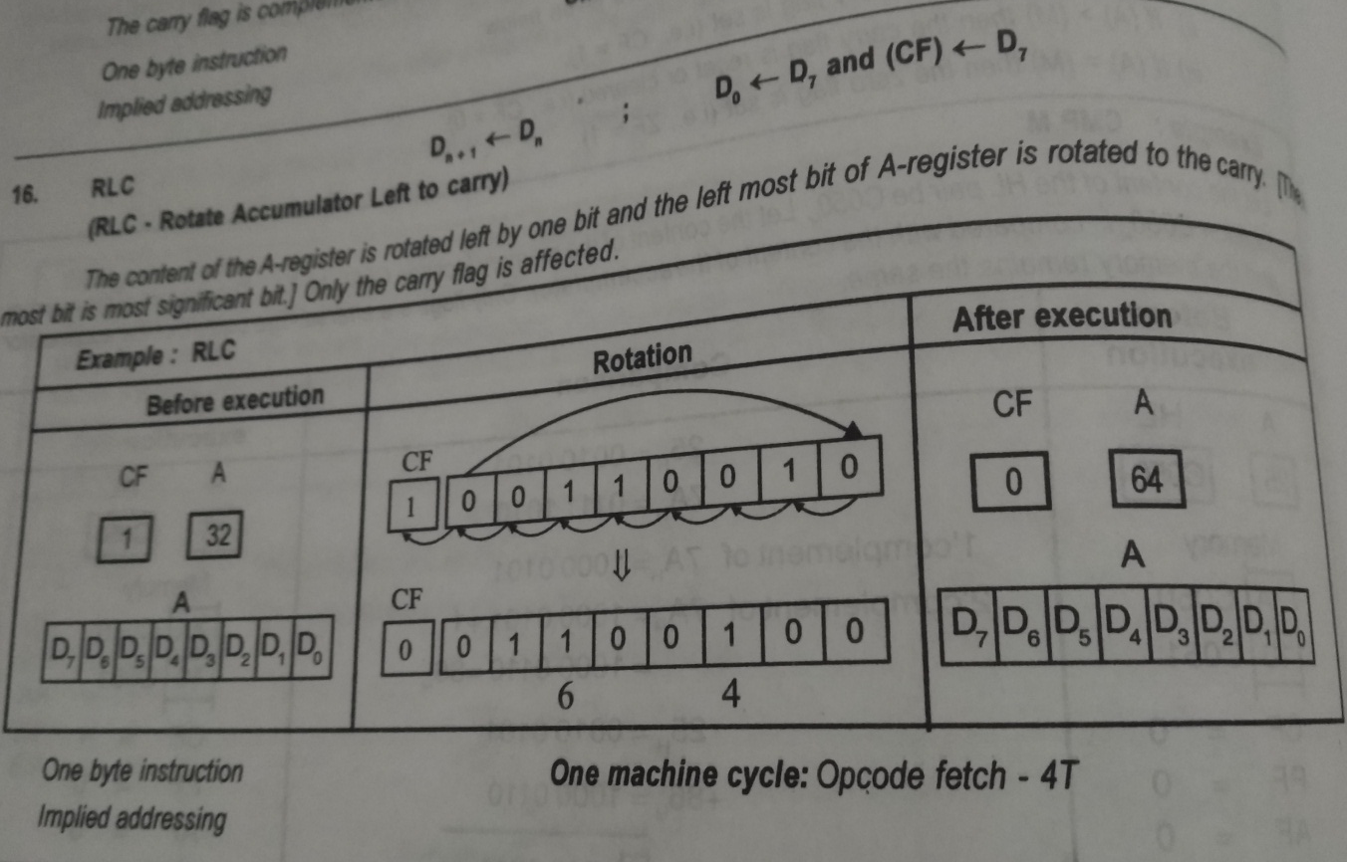
Rlc instructions

Slide 34
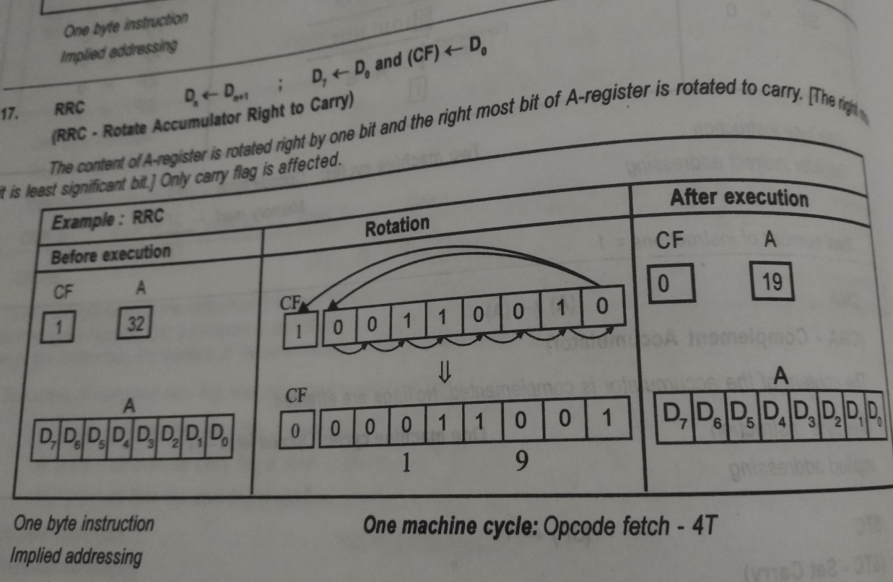
Rrc instructions

Slide 35
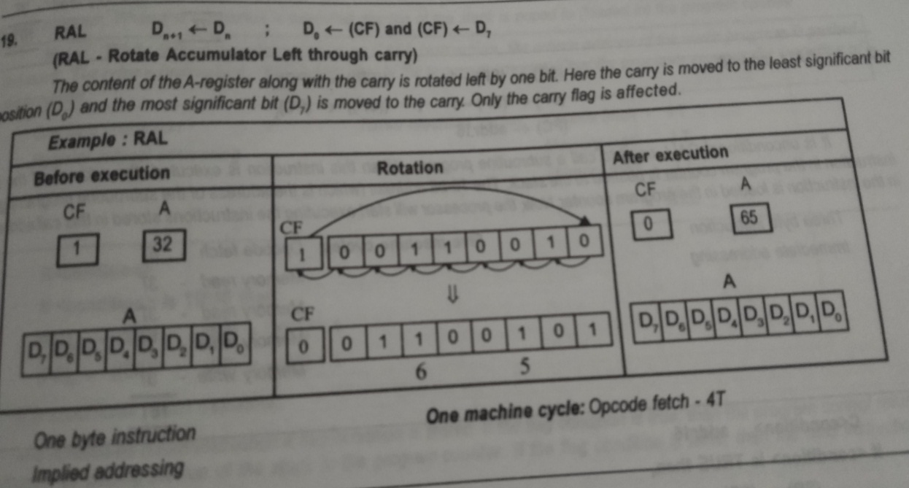
Ral instructions

Slide 36
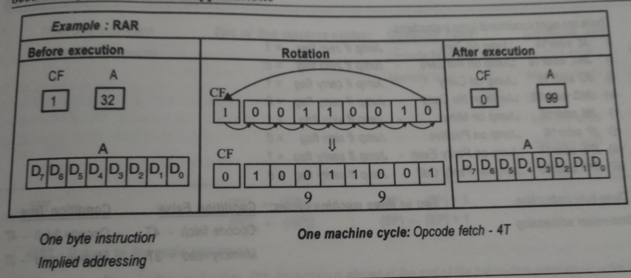
Rar instructions

Slide 37
Other instructions
CMA (Complement accumulator)
The content of the accumulator is complemented. No flags are affected.
STC (Set Carry)
The carry flag is set to 1. Only carry flag is affected by this instruction
CMC (Complement carry)
The carry flag is complemented. Only the carry flag is affect this instruction.

